Slide 1
Presented by Tullio Tolio

Slide 2
OUTLINE
Introduction
Problem formulation
Bosch case
  Presentation
  Modeling
  Threshold considerations
Conclusions

Slide 3
OUTLINE
Introduction
Problem formulation
Bosch case
  Presentation
  Modeling
  Threshold considerations
Conclusions

Slide 4
1. Introduction
Goal of lean production systems :
High productivity
Reduction of activities without an added value
Low lead time and WIP
High flexibility
High service level
Usual methodologies:
Kanban cards
Total productive maintenance
Components standardization
Flexible manpower

Slide 5
1. Introduction
Unfortunately some traditional “lean techniques” loose effectiveness when the competitive scenario changes over time.
The need of methodologies to understand how and when a system must be reconfigured arises and their main purpose is to tackle impendent risks and to react to some changes which affect the system performance.

Slide 6
OUTLINE
Introduction
Problem formulation
Bosch case
  Presentation
  Modeling
  Threshold considerations
Conclusions

Slide 7
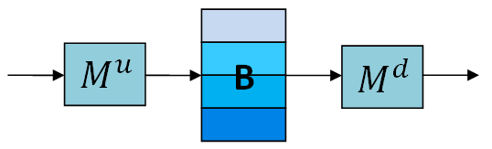
2. Problem formulation –
General modeling
The modeling recalls the Multithreshold model presented in Tolio and Ratti (2013).
The system is modeled with three elements :
  Upstream machine which delivers material in the buffer
  Downstream machine which withdraws material from the buffer
  The buffer has a finite capacity and is divived in ranges by means of thresholds
Moreover, the machine behavior is described by continuous-time mixed-states Markov chains and each machine can have a different Markov chain for each inventory range.

Slide 8
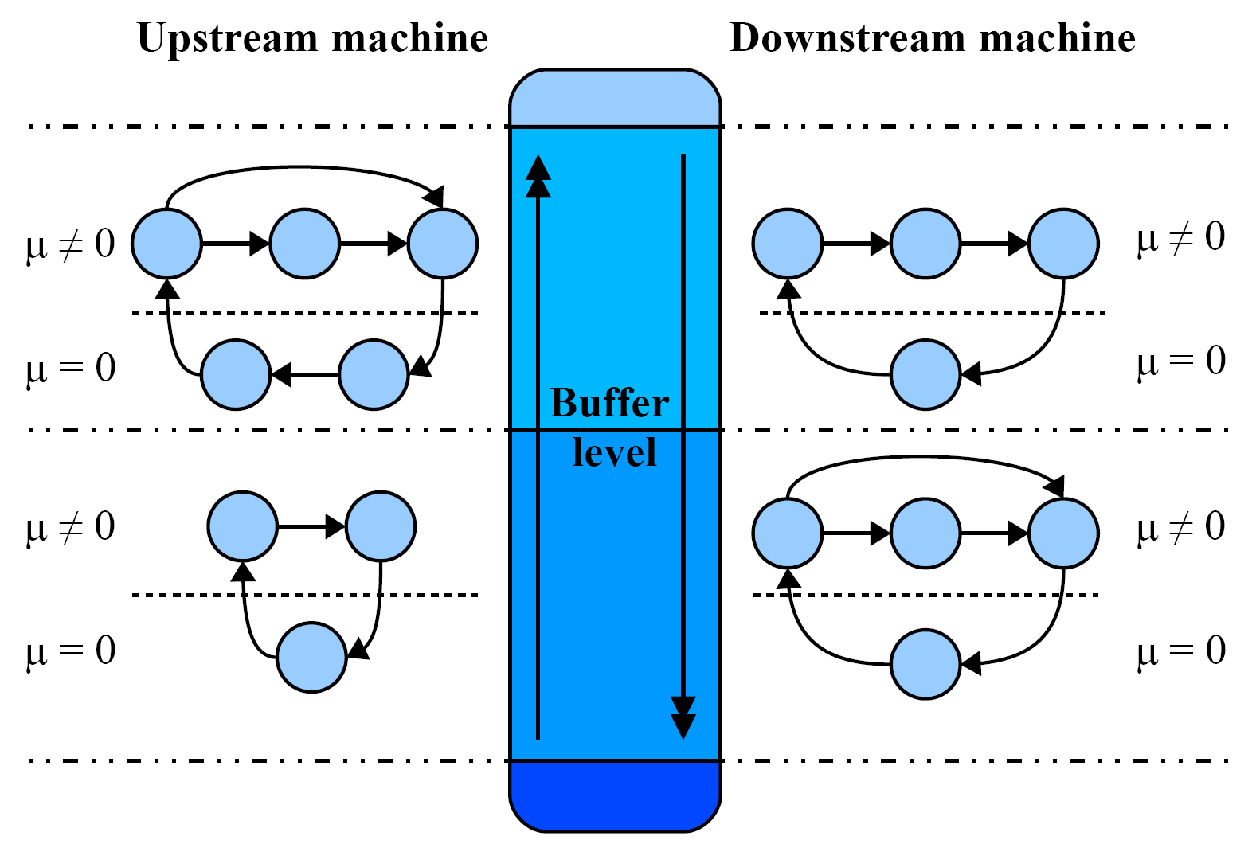
2. Problem formulation –
General modeling
As a consequence, the system behaves differently above or below a certain buffer level. While crossing a threshold, certain state changes can happen.

Slide 9
2. Problem formulation –
General modeling
Additionally on-threshold states may be considered.
A set of boundary equations connect the states lying on the adjacent buffer ranges to each other and to on-threshold states.
This methodology can be used to evaluate the effectiveness of inventory control policies.

Slide 10
2. Problem formulation
Assumptions:
The upstream and downstream machines M^{u} and M^{d} have respectevely C_{u} and C_{d} alternative configurations each having its productive behavior defined by a Markov chain.
^{Mu–Conf 1}
^{Mu –Conf 2}
^{Mu –Conf Cu}
U₁
U₂
U
…
r₁
p₁
r₂
p₂
r_{Cu}
p_{Cu}
D₁
D₂
D
^{Md–Conf 1}
^{Md –Conf 2}
^{Md –Conf Cd}
U₁
U₂
U
…
r₁
p₁
r₂
p₂
r_{Cu}
p_{Cu}
D₁
D₂
D

Slide 11
2. Problem formulation
The system as a whole has C_{u} · C_{d} possible configurations.
System Configuration i,j
^{Mu–Conf i}
^{Md–Conf j}
U_{i}
U_{j}
r_{i}
p_{i}
r_{j}
p_{j}
D_{i}
D_{j}

Slide 12
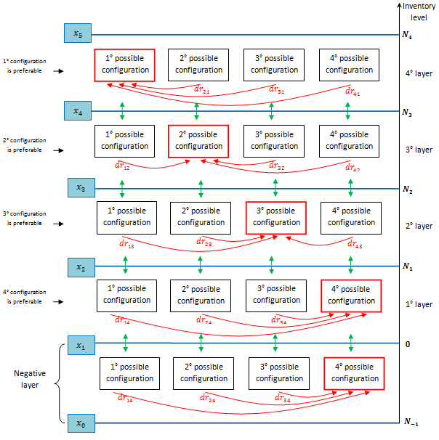
The overall buffer range is divided in C_{n} ranges and for each range a most desirable system configuration is defined.
If, in a given buffer range, the current system configuration is not the most desirable one, the system tries to reconfigure into the most desirable configuration but with a certain delay.

Slide 13
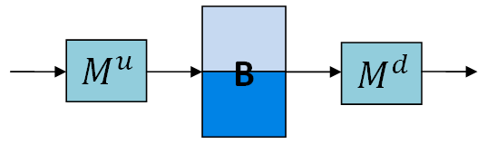
2. Problem formulation –
Performance evaluation
Let us consider a simple case where:
M^{u} has 2 possible configurations and M^{d} only 1 (i.e. 2 possible system configurations).
Parameters are chosen in such a way that in one system configuration the buffer tends to increase and in the other to decrease.
50-100% of the overall buffer range : configuration 2 is preferable
0-50% of the overall buffer range : configuration 1 is preferable

Slide 14
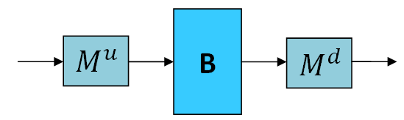
2. Problem formulation –
General modeling
When the buffer level is high, the most desirable configuration tend to reduce the buffer level (and therefore the inventory costs).
When the buffer level is low, the the most desirable configuration tend to increase the buffer level (and therefore the backlog costs)

Slide 15
2. Problem formulation –
Performance evaluation
The objective cost function considers :
Inventory costs
Backlog costs
Running Costs of each configuration
For the considered system for a given value of the threshold, a value for the objective function is obtained.
Since the threshold levels are a choice of the system designer, it is interesting to find their optimal value

Slide 16
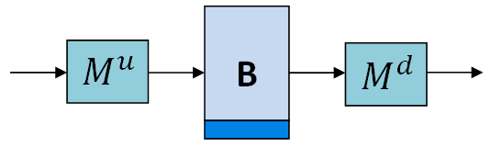
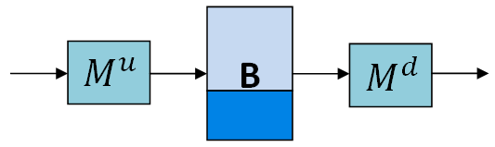
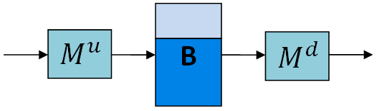
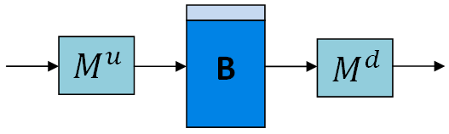
2. Problem formulation –
Optimization
Starting from the first case (threshold level = 50% of the overall buffer capacity), it is possible to repeat the analytical computation with different threshold levels and find out the minimum of the OF.
Threshold level = 20%
Threshold level = 35%
Threshold level = 50%
Threshold level = 65%
Minimum value for threshold level=35%
Threshold level = 80%

Slide 17
2. Problem formulation –
Optimization
Given the configurations assigned to each buffer range, the only parameters to be optimized are the threshold levels.
In case of more than one threshold, more than one parameter must be optimized at the same time.

Slide 18
OUTLINE
Introduction
Problem formulation
Bosch case
  Presentation
  Modeling
  Threshold considerations
Conclusions

Slide 19
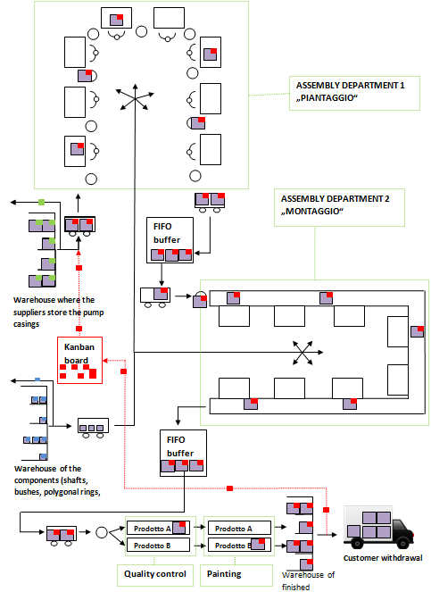
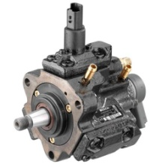
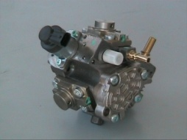
3. Bosch case –
Presentation
Products :
2 pump families
About 60 variants for each family
Final department layout :
Component warehouse
Assembly 1
Assembly 2
Quality check
Painting
Warehouse of finished products

Slide 20
3. Bosch case –
Presentation
CUSTOMERS :
They communicate the estimated daily demands monthly
The withdrawal schedule is not binding
WEEKLY MEETING ON FRIDAY:
Considering the actual inventory level, it is decided how many shifts must be planned in the following week. 4 alternatives are available : 12, 14, 15 or 16 shifts.
The chosen number of shifts cannot be changed during the week.

Slide 21
OUTLINE
Introduction
Problem formulation
  General modeling
  Performance evaluation
  Optimization
Bosch case
  Presentation
  Modeling
  Threshold considerations
Conclusions

Slide 22
3. Bosch case –
Modeling
Upstream machine :
As a result, the inventory level can be controlled by the number of scheduled shifts (4 available configurations) which affects the expected value and the variance of the upstream weekly throughput.
Reconfiguration delay :
The threshold crossing can occur in each day of the week with the same probability but the system must wait until the meeting on Friday for the reconfiguration.
Mean delay = ½ week

Slide 23
3. Bosch case –
Modeling
Downstream machine :
Demand behavior not dependent on the current inventory level
Only 1 downstream configuration modeled by a generic Markov chain obtained from real data
Downstream configuration :
Demand Markov chain

Slide 24
3. Bosch case –
Modeling
Negative layer

Slide 25
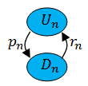
3. Bosch case –
Modeling
Each box represents the sub-Markov chain of the corresponding configuration.
In the Bosch real case each sub-Markov chain contains 1 up state with rate equal to the nominal weekly rate and 1 down state modeling the down-times.
The two states are connected by one failure and one repair transition.
N-th possible configuration
When a reconfiguration occurs, the system remains up or down (no contemporary failures or repairs) but goes to the corresponding up or down state of the new configuration.
N.B. In general the sub-Markov chain can include whatever number of states to fit the real production behavior as well as possible.

Slide 26
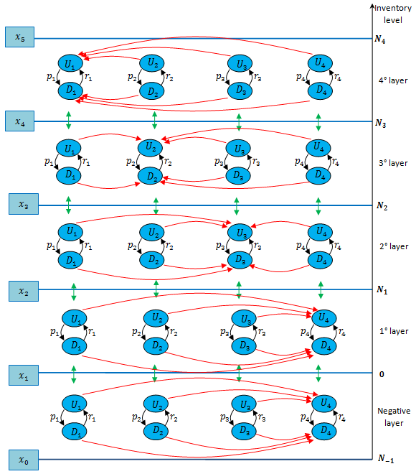
3. Bosch case –
Modeling
Mu
Md

Slide 27
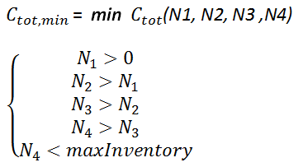
3. Bosch case –
Modeling
Once the model structure is defined, the optimization can be carried out :
Constraints :
During the weekly meeting, the number of shifts which is preferable for the current inventory level (considering the ranges defined by the optimal thresholds) is planned for the following week.

Slide 28
OUTLINE
Introduction
Problem formulation
  General modeling
  Performance evaluation
  Optimization
Bosch case
  Presentation
  Modeling
  Threshold considerations
Conclusions

Slide 29
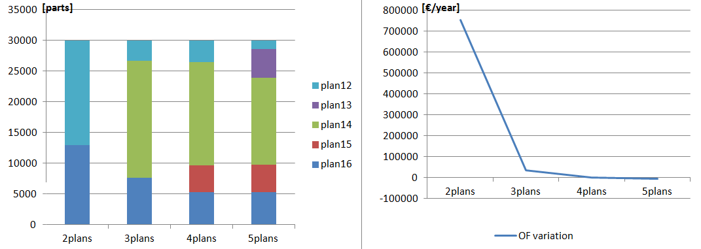
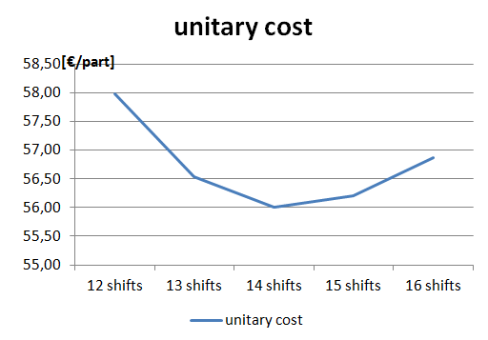
3. Bosch case –
Threshold considerations
NUMBER OF CONFIGURATIONS
The more available configurations, the lower the costs.
Most of the benefits are already obtained with 4 alternative configurations

Slide 30
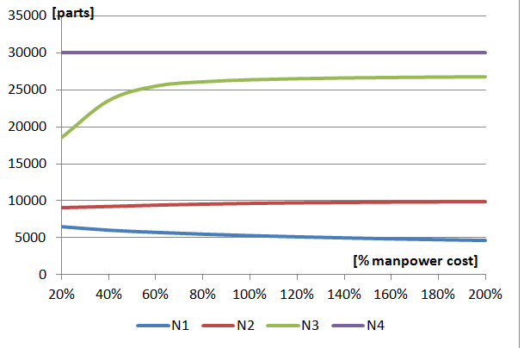
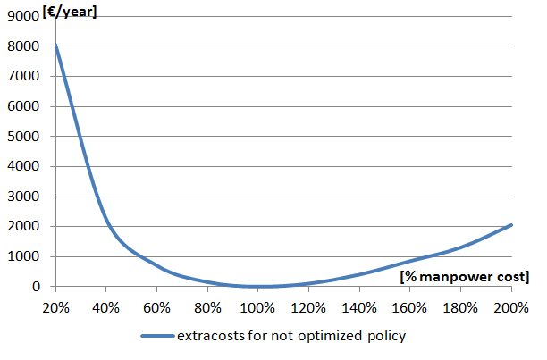
3. Bosch case –
Threshold considerations
MANPOWER COSTS
The backlog and inventory costs become more and more important to optimize if the manpower becomes cheaper (fig.1)
Production contexts where the manpower has different costs must have also different thresholds. Otherwise extra-costs are experienced (fig.3)

Slide 31
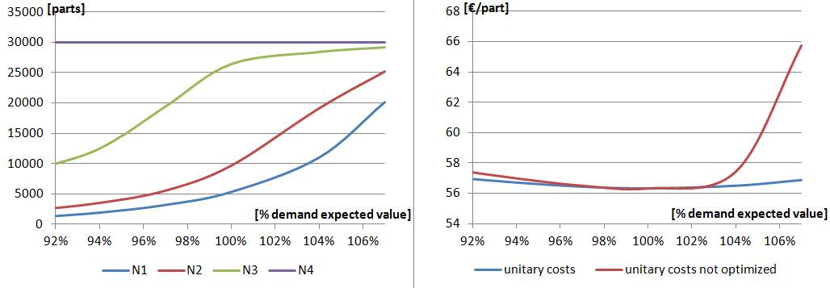
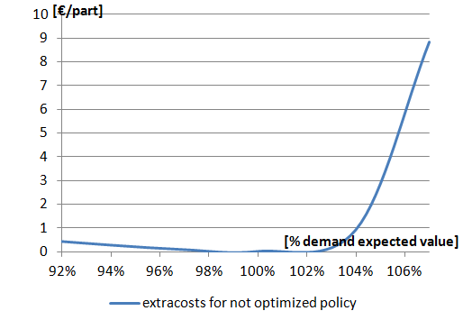
3. Bosch case –
Threshold considerations
DEMAND EXPECTED VALUE
If the demand expected value increases :
The configurations with a higher number of shifts are more and more used
The minimum global cost is obtain when the mean demand rate is similar to the expected production rate of the more cost-efficient configurations (14 and 15 shifts)
The extra-costs increases must faster if the costs are underestimated than vice versa

Slide 32
OUTLINE
Introduction
Problem formulation
  General modeling
  Performance evaluation
  Optimization
Bosch case
  Presentation
  Modeling
  Threshold considerations
Conclusions

Slide 33
4. Conclusions
RESEARCH CONTRIBUTIONS :
Quantitative tool to evaluate and optimize the costs of a reaction policy in a competitive scenario.
A logical guideline to address many real cases has been provided (possibility to represent configurations with different reconfiguration time, cost and productive behavior).
Fast and exact solution thanks to analytical multi-threshold model.
ACHIEVEMENTS OF THE PRACTICAL CASE :
Quantification of the advantage of dynamically reoptimize the thresholds.
Efficiency improvement in the scheduling of weekly shifts through a cost-oriented model with a little management effort.

Slide 34
Thank you !
Tullio Tolio

Slide 35


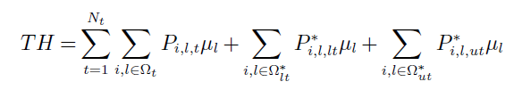


2. Problem formulation –
Performance evaluation
After the solution of the building block with multiple thresholds it is possible to calculate the following performance indexes :

Slide 36
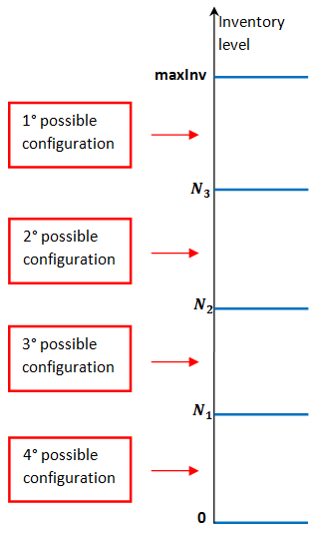
3. Bosch case –
Modeling
Since 4 system configurations are available, 4 buffer ranges must be defined and for each of them a configuration must be assigned as “preferable”.
1° possible configuration = 12 shifts
2° possible configuration = 14 shifts
3° possible configuration = 15 shifts
4° possible configuration = 16 shifts
N.B.
One extra negative buffer range will be added to model the backlog.

